Slide 1
CSE413 – Security of Information Systems 2020 PhD Furkan Gözükara, Toros University https://github.com/FurkanGozukara/Security-of-Information-Systems-CSE413-2020
Lecture 12
Application Security
Composed from Prof. Audun Jøsang, University of Oslo, Information Security 2018 Lectures
Source : https://www.uio.no/studier/emner/matnat/ifi/INF3510/v18/lectures/

Slide 2
Outline
Application Security (Audun Jøsang)
Malicious Software
Attacks on applications
Secure system development
Security by Design (Dagfinn Bergsager, USIT)
Industrial Approach (Espen Johansen, VISMA)
2

Slide 3


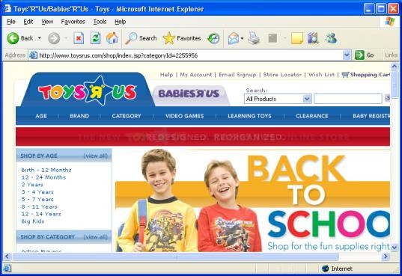
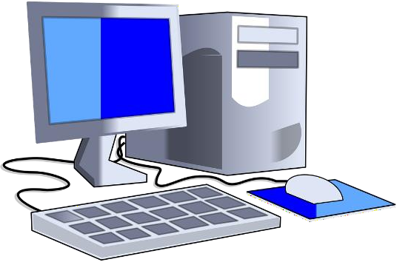






How do computers get infected ?
Executing attachments to emails which
contain exploits or malicious programs
Accessing a malicious or infected website which contains a malicious script, or installing and starting malicious programs from a website
Direct attacks from the network, which e.g. exploit vulnerabilities in OS or applications such web servers or SQL databases
Plugging in external devices that are infected with malicious software
Installing infected/malicious software
3

Slide 4






Malware types
Backdoor or trapdoor
Logic bomb,
Trojan horse
Worm
Virus
Stealth virus
Uses techniques to hide itself, e.g. encryption
Polymorphic virus
Different for every system
Metamorphic virus
Different after every activation on same system
Exploit
An tool to infect systems by using malicious program or input data (e.g.
document) that triggers and exploits a software bug in the systems
4

Slide 5
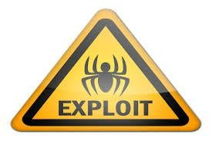

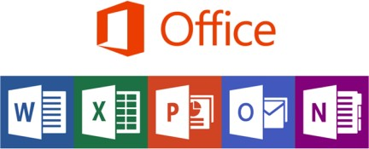


Exploits
A piece of software, data, or a sequence of
commands that exploits a software/hardware vulnerability
Can be carried in common data formats such as pdf documents, office documents or media files.
Often contains carefully designed corrupt datatypes
Causes unintended or unanticipated behavior to occur on computer software or hardware
Exploit functionality typically is to
Download a program/backdoor which allows the attacker to
control the platform
Directly take control of a computer system, allowing privilege escalation, or a denial-of-service or other sabotage.
5

Slide 6

Backdoor or Trapdoor
Installed by exploit:
Provides remote control capabilities by attackers
Can reside on system for long periods before being used
Can be removed after use
Installed by user:
User can be tricked to install malicious program (see Trojan horse)
Installed during design:
is a hidden/secret entry point into a program,
allows those who know access bypassing usual security procedures
is commonly used by developers for testing
is a threat when left in production software allowing, exploit by attackers
is very hard to block in O/S
• can be prevented with secure development lifecycle
6

Slide 7









The Cyber Kill Chain
(Hutchins et al. 2011)
Cyberthreat execution and possible steps to kill it
Time scale
1
Reconaissance
Days, months, years
2
Weaponisation
Days, months
3
Delivery
Minutes, hours
4
Exploitation
Milliseconds
5
Installation
Seconds
6
C&C
Hours, days
7
Action/Exfiltration
Hours, days, years
7

Slide 8
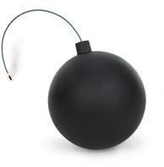
Logic Bomb
one of oldest types of malicious software
code embedded in legitimate program
activated when specified conditions met
eg presence/absence of some file
particular date/time
particular user
causes damage when triggered
modify/delete files/disks, halt machine, etc
8

Slide 9
Trojan Horse
program with hidden side-effects
e.g. a back door
program is usually superficially attractive
eg game, s/w upgrade etc
performs additional tasks when executed
allows attacker to indirectly gain access they do not
have directly
often used to propagate a virus/worm or to install a backdoor
… or simply to destroy data
9

Slide 10

Malicious Mobile Code
Program/script/macro that runs unchanged
on homogeneous platforms (e.g. Windows)
will only affect specific platforms
on heterogeneous platforms
will affect any platform that supports script/macro language
e.g. Office macros
Transmitted from remote system to local system & then
executed on local system
To inject Trojan horse, spyware, virus, worm etc. which can
directly perform specific attacks, such as unauthorized data access, root compromise, sabotage
indirectly infect other systems and thereby spread
10

Slide 11
Viruses
piece of software that infects programs
specific to operating system and hardware
taking advantage of their details and weaknesses
a typical virus goes through phases of:
dormant
propagation
triggering
execution
11

Slide 12

Worms
Replicating programs that propagate over net
Access remote systems via network protocols to open ports
Attack vulnerable processes in remote systems
Can also use email, remote exec, remote login
Can have characteristics like a virus:
Dormant, triggering, execution, propagation & replication
Propagation phase: searches for other systems to infect
May disguise itself as a system process when executing
Morris Worm, the first and the best know worm, 1988
released by Robert Morris Jr., paralyzed the Internet (of 1988)
exploited vulnerabilities in UNIX systems
WannaCry Worm, epidemic infection in May 2017
exploits known, but unpatched, vulnerability in Windows XP
12

Slide 13
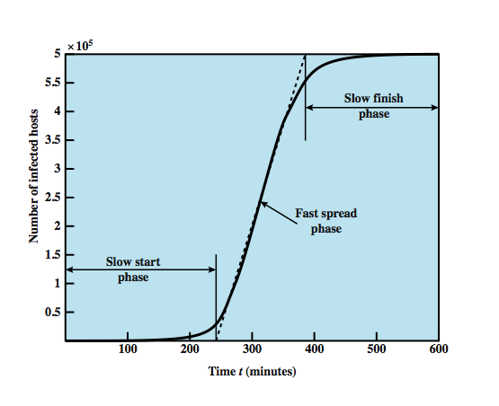
Worm Propagation Speed
13

Slide 14
What is a botnet ?
A botnet is a collection of computers infected with malicious software agents (robots) that can be controlled remotely by an attacker.
Owners of bot computers are typically unaware of infection.
Botnet controller is called a "bot herder" or "bot master"
Botnets execute malicious functions in a coordinated way:
Send spam email
Collect identity information
Denial of service attacks
Create more bots
Bitcoin mining
A botnet is typically named after the malware used to infect
Multiple botnets can use the same malware, but can still be operated by different criminal groups
14

Slide 15
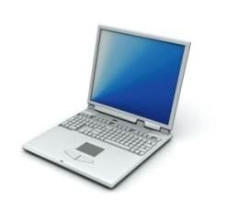

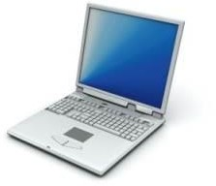



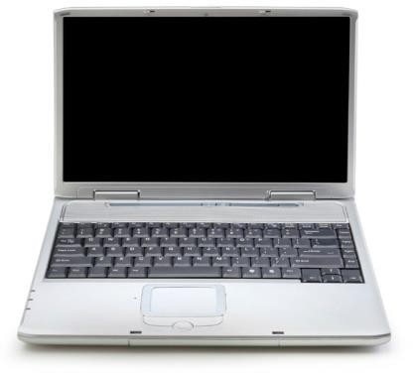




Botnet Architecture
Victims
Bots
Bot-herder
15

Slide 16
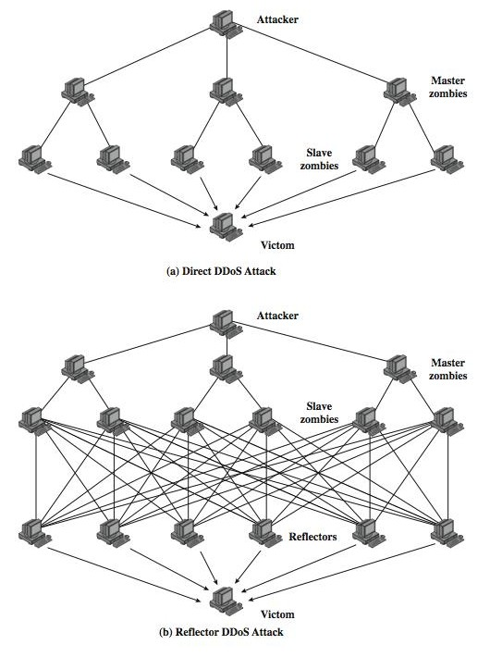
Direct attack
– Bots send traffic with own or spoofed sender address to victim
DDoS
Flood Types
Reflected attack
– Bots send traffic to innocent hosts with victim address as sender address. Innocent hosts become part of attack by replying to victim.
L
12: App. Security
16

Slide 17



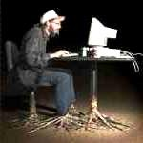




The web application security challenge
Your security “perimeter” has huge holes at the application layer
Application Layer
Databases
Legacy Systems Web Services Directories Human Resrcs Billing
Custom Developed
Applic on Code
APPLICATION ATTACK
ati
App Server Web Server Hardened OS
Network Layer
Firewall
Firewall
Network security (firewall, SSL, IDS, hardening) does not stop application attacks
17

Slide 18
What is SQL?
Structured Query Language: interface to relational database systems.
Allows for insert, update, delete, and retrieval of data in a database.
ANSI, ISO Standard, used extensively in web applications.
Example:
select ProductName from products where ProductID = 40;

Slide 19
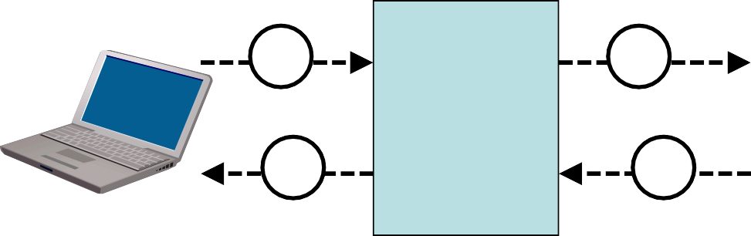
SQL at back-end of websites
Take input from a web-form via HTTP methods such as POST or GET, and pass it to a server-side application.
Application process opens connection to SQL database.
Query database with SQL and retrieve reply.
Process SQL reply and send results back to user.
SQL interface
Application Server
Database Server
1
2
3
Web Server
4
4
3

Slide 20
What is SQL Injection?
Database system misinterpretation of input data
Attacker disguises SQL commands as data-input
Disguised SQL commands = ‘injected’ SQL commands
With SQL injection, an attacker can get complete control of database
no matter how well the system is patched,
no matter how well the firewall is configured,
Vulnerability exists when web application fails to sanitize data input before sending to it database
Flaw is in web application, not in SQL database.

Slide 21
What is SQL Injection?
For example, if input field ask for a product number, but the malicius user inputs “40 or 1 = 1”
The result SQL command becomes:
select ProductName from products where ProductID = 40 or 1 = 1
1=1 is always TRUE so the “where” clause will always
be satisfied, even if ProductID ≠ 40.
All product records will be returned.
Data leak.

Slide 22

XKCD – Little Bobby tables

Slide 23

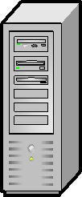


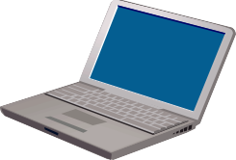
Stored XSS
Store and display attack script on web page
Access web page
Victim
2
3
Web server trusted by victim
4
5
Script executes
Attack script sent in web page to client
1
Attacker
Input to website in the form of attack script disguised as user content

Slide 24
Stored XSS
Data provided by users to a web application is stored persistently on server (in database, file system, …) and later displayed to users in a web page.
Typical example: online message boards.
Attacker uploads data containing malicious script to server.
Every time the vulnerable web page is visited, the malicious script gets executed in client browser.
Attacker needs to inject script just once.
24

Slide 25
Preventing SQL Injection and XSS
Validate all user entered parameters
CHECK data types and lengths
DISALLOW unwanted data (HTML tags, JavaScript, SQL commands)
ESCAPE questionable characters (ticks, --,semi-colon, brackets, etc.)
Hide information about Error handling
Error messages divulge information that can be used by hacker
Error messages must not reveal potentially sensitive information
25

Slide 26
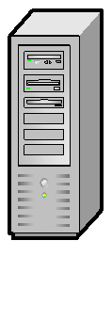
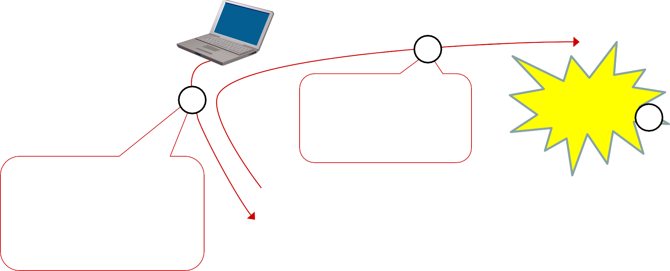

Broken Authentication and Session Mgmt
Provide service, and let user stay logged-in
Login to website
to access service
Alice
Web server trusted by user
1
2
4
3
Access website as Alice and request service
Request fulfilled
5
Email info about website, including URL containing session Id
Cheshire Cat
L12: Dev.Ops. Security
UiO INF3510 - Spring 2014
26

Slide 27
Broken Authentication and Session Mgmnt Problem and Fix
User authentication does not necessarily provide continuous authentication assurance
User authentication is only at one point in time
Insecure implementation of session control with a static session Id which is passed in the URL
Unfortunately this can be misused
Recommendations for session Id must be followed
E.g friom OWASP
Examples of controls for session Id:
Link session Id to e.g. IP address, TLS session Id
.

Slide 28

OWASP
The Open Web Application Security Project
Non-profit organisation
Local chapters in most countries, also in Norway
OWASP promotes security awareness and security solutions for Web application development.
OWASP Top-10 security risks identify the most critical security risks of providing online services
The Top 10 list also recommends relevant security solutions.
OWASP ASVS (Application Security Verification Standard) specifies requirements for application-level security.
Provides and maintains many free tools for scanning and
security vulnerability fixing

Slide 29

Top-10 Web Application Risks
Injection
Broken Authentication and Session Management
Cross-Site Scripting (XSS)
Insecure Direct Object References
Security Misconfiguration
Sensitive Data Exposure
Missing Function Level Access Control
Cross-Site Request Forgery (CSRF)
Using Components with Known Vulnerabilities
Unvalidated Redirects and Forwards

Slide 30

General Data Protection Regulation
EU legislation is translated unchanged
Paragraphs §25 and §32 are particularly relevant to security
Requirement of privacy by design and security by design
IT designers must know the principles of privacy by design and security by design,
– otherwise, the system are illegal to use by definition
Fines up to € 20,000,000 or 4% of revenue
The Norwegian Parliament Stortinget decided on 10 April 2018 that IT education programs must have mandatory courses in information security
ttps://www.tekna.no/aktuelt/tekna-gjennomslag-om-ikt-sikkerhet-i-utdanningen/
IN1030 2018
Innebygd informasjonssikkerhet

Slide 31

Security by Design is a legal requirement
under GDPR
Requirements
Operations
Design
Training
Deployment
Coding
Test
IN1030 2018
Innebygd informasjonssikkerhet

Slide 32












Agile Software Development
Project planning
Select user stories for the next release
Break down user story into functions
Plan new release
Evaluate current
system
Develop, integrate &
test new functionality
Release new software
Requirements are specified as stories
Each story implemented as sprint
Repeated sprint cycles until all stories are implemented
Deploy system

Slide 33





















Secure Agile Software Development
Project planning
Collect stakeholder security concerns
Select user stories for next release
Break down user story into functions
Plan new release
Identify threat scenarios to control
Evaluate system & review security
Release new software
Develop, integrate & test new function
Secure agile SDLC is challenging
Add security related development tasks
– (yellow boxes)
Security necessarily maks SDLC less agile
Deploy system

Slide 34
End of Lecture

